Slide 1

Recruiting & informing online participants
Janet Salmons, PhD

Slide 2
Informing participants and
Verifying consent online: From forms to clicks
Your target population
Language
Images or Media
ICT?

Slide 3

#1 Challenge: building trust and credibility.
Why should participants trust you?

Slide 4
Researcher blog or page
Introduce yourself (and research team) and 1. include contact information.
Link to agency or to institution.
Describe purpose of the study.
Explain expectations.
Explain benefits to society.
Link to the blog in emails, posts, social media or other recruitment communications.

Slide 5
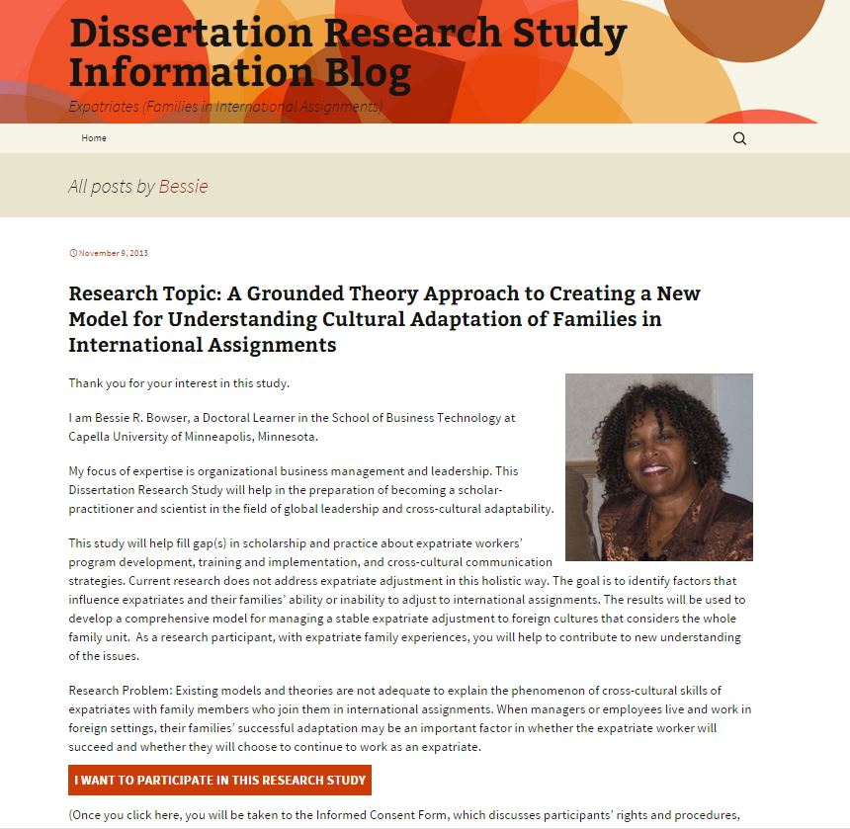
Researcher blog

Slide 6
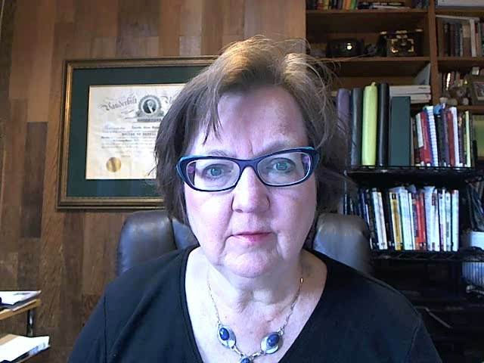
Podcast or video
Link to online questionnaire to gather information related to study inclusion criteria.
Upload to YouTube and post link on social networking sites and in recruitment materials.
Link to video: https://youtu.be/dLhIZO44chk

Slide 7
A couple of years ago I interviewed a group of such women entrepreneurs—and wrote a book chapter about what I learned. Now I want to build on that research. I am interested in women who use technology to connect with customers, vendors and allies in businesses that deal with real-world, physical goods and services (architecture, counseling, crafts) or digital world goods and services (online facilitation, consulting on social media or blogging.) I am not interested in financial or confidential business information—and you’ll have a chance to review any interview notes before I publish anything. If you are interested, please click the link for a short questionnaire and agreement, and let me know how to reach you to take the next step.
Credibility and experience of researcher
Inclusion criteria.
Exclusion criteria and reassurance that private information is not being requested.
Protection and control over data.
Link to get started without delay.

Slide 8
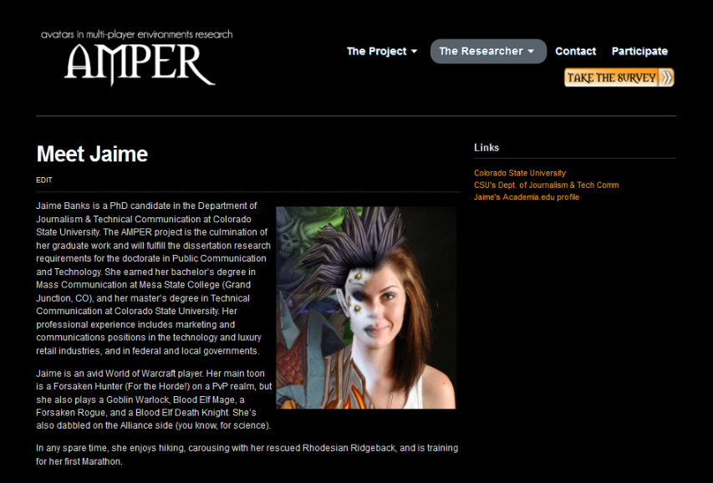
Researcher as avatar

Slide 9
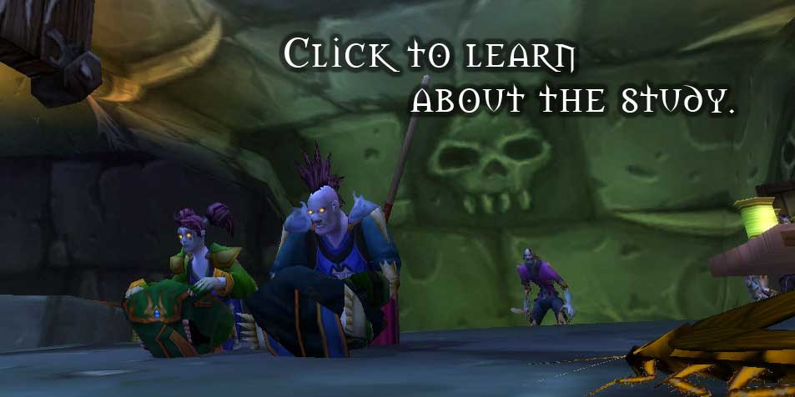
Option: Game
Dr. Banks (2014)said, "Players were invited to visit a website with informed consent information and a screening survey with items measuring demographics, gameplay habits, and thoughts, feelings, and memories regarding a favorite WoW avatar."

Slide 10

Forum Post
Research!
The second stage in the research process, entrance in the field, …occurred after three months of non-participant observation in the selected community. After obtaining consent from the community owner, we created a topic on the community discussion board describing the research project and requesting the consent of all members to collect data and use the information from the community for academic purposes. Nine members replied to the post, all agreeing with the proposed research. The thread was kept on the forums during all of the data collection phase and no concerns or negative responses from community members were registered. (Scaraboto, Rossi, & Costa, 2012, p. 252-253)

Slide 11
References
Banks, J. (2014). Object-relation mapping: A method for analysing phenomenal assemblages of play. Journal of Gaming & Virtual Worlds, 6(3), 235-254. doi: 10.1386/jgvw.6.3.235_1
Banks, J., & Bowman, N. D. (2014). Avatars are (sometimes) people too: Linguistic indicators of parasocial and social ties in player–avatar relationships. New Media & Society. doi: 10.1177/1461444814554898
Scaraboto, D., Rossi, C. A. V., & Costa, D. (2012). How consumers persuade each other: Rhetorical strategies of interpersonal influence in online communities. Brazilian Administration Review (BAR), 9(3), 246-267.

